Slide 1
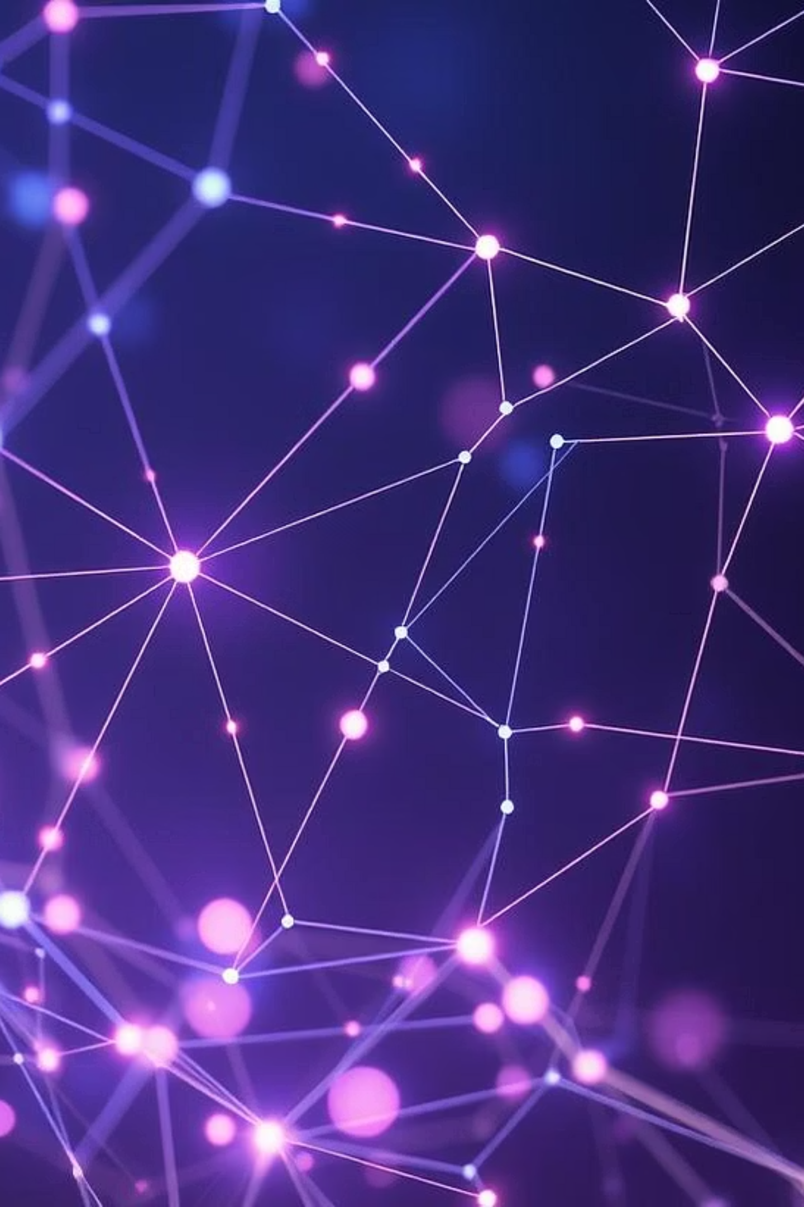
Image Captioning and Segmentation Using Deep Learning
Presented by: [Your Name]

Slide 2


Introduction to Image AI
This project explores two key areas of computer vision:
Image Captioning
Image Segmentation
Generating descriptive text for images.
Dividing images into meaningful regions or objects.

Slide 3
Project Objectives
1
Develop a system
2
Implement image segmentation
3
Utilize deep learning models
To automatically generate captions for input images.
To identify and outline objects within images.
For accurate and efficient processing.

Slide 4




Tools and Technologies Used
We leveraged popular deep learning frameworks and development environments for this project.

Slide 5
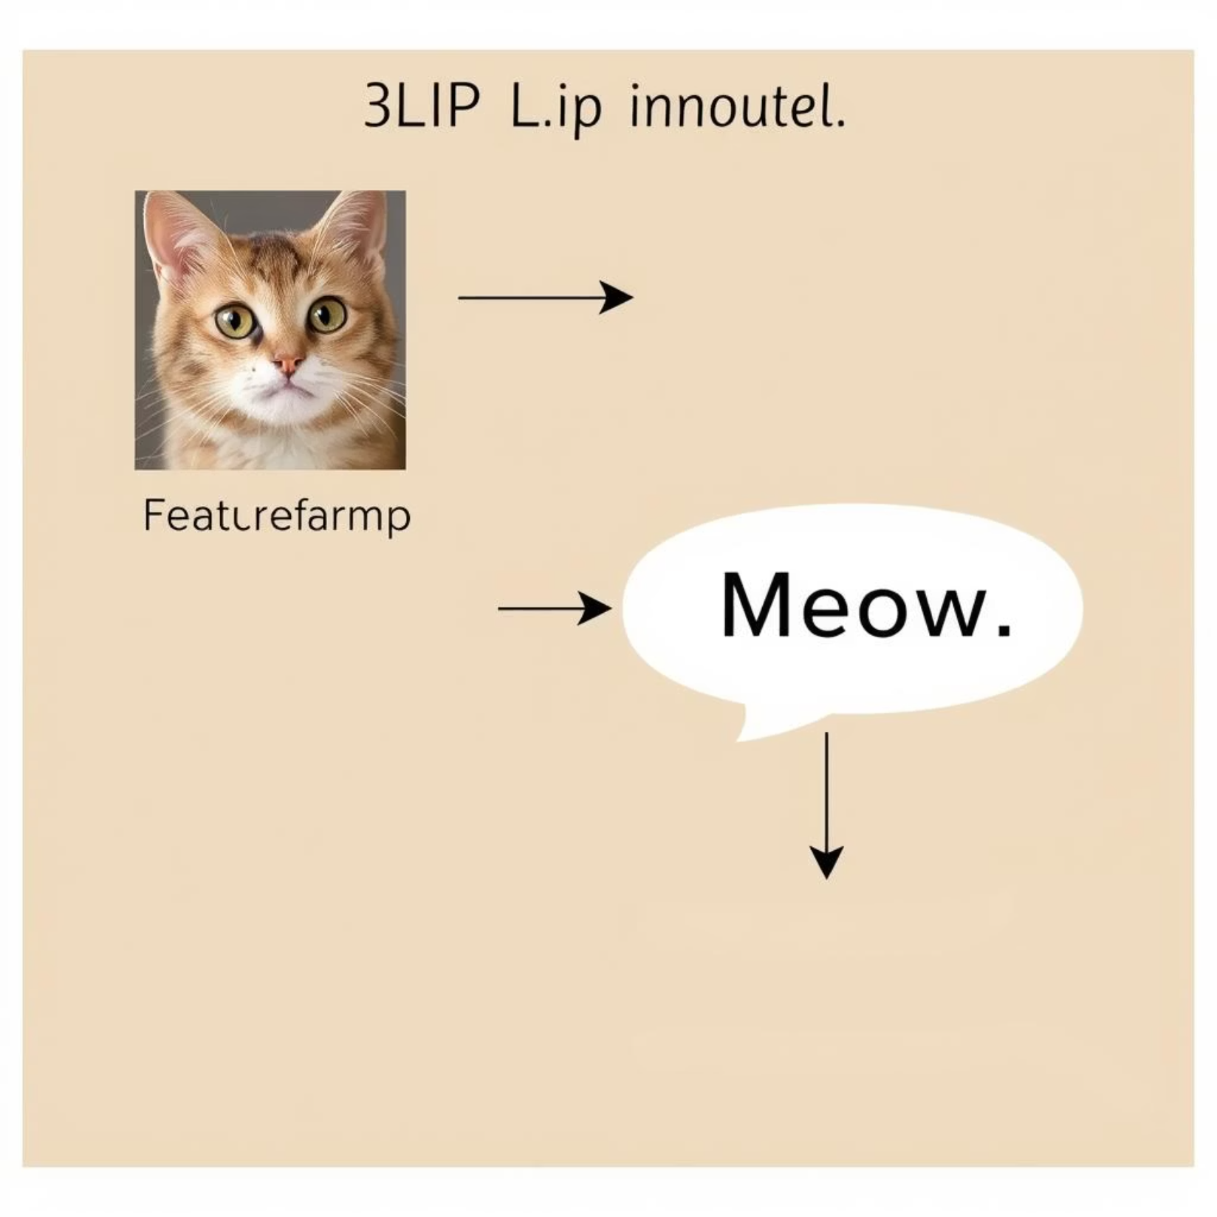
How Image Captioning Works: BLIP Model
The BLIP (Bootstrapping Language-Image Pre-training) model is used for image captioning.
Combines vision and language understanding.
Generates natural language descriptions from images.
Pre-trained on large datasets for robust performance.

Slide 6
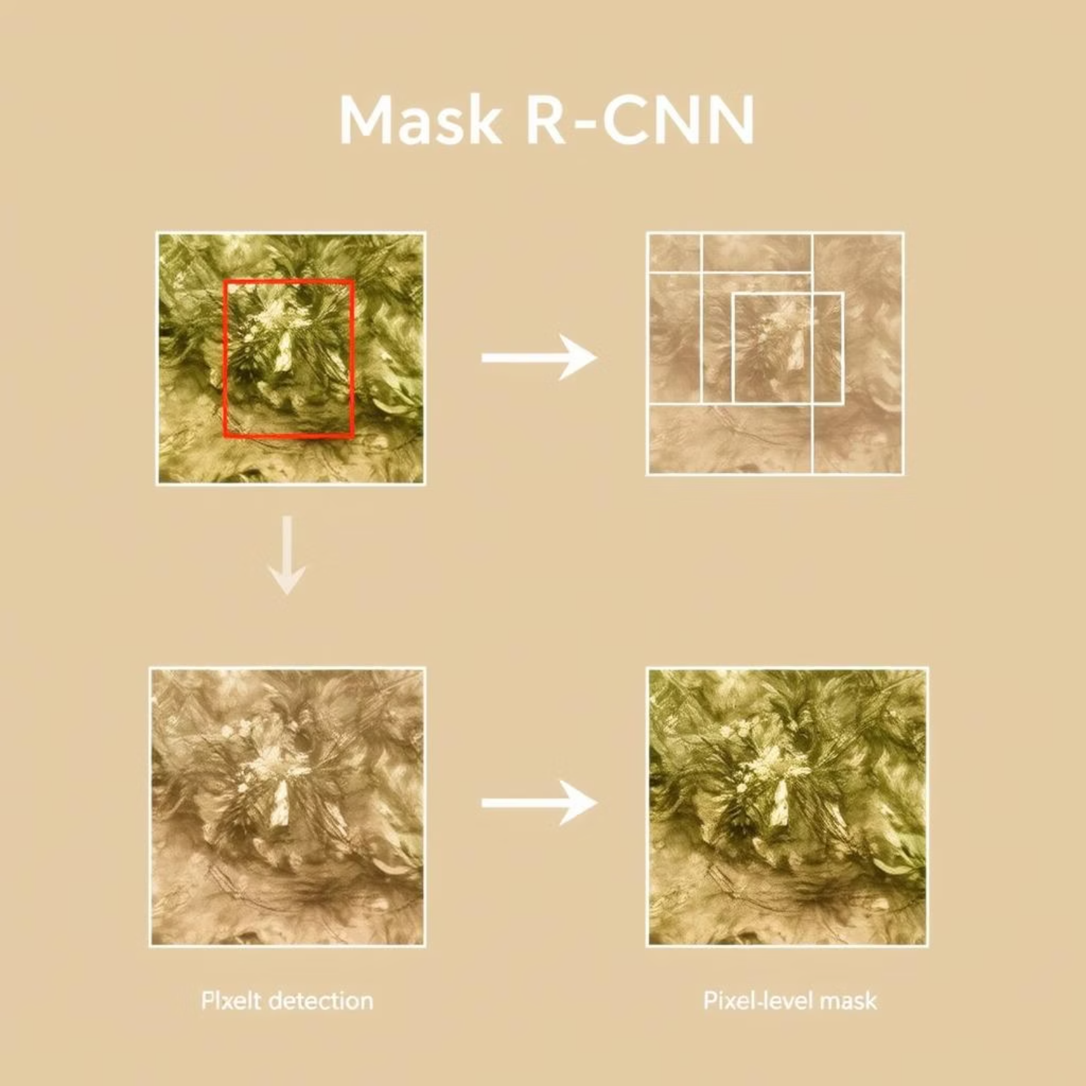
Image Segmentation: Mask R-CNN
Mask R-CNN is a state-of-the-art model for instance segmentation.
Detects objects in an image.
Generates a precise segmentation mask for each detected object.
Used pre-trained models on large datasets like MS COCO and Pascal VOC.

Slide 7
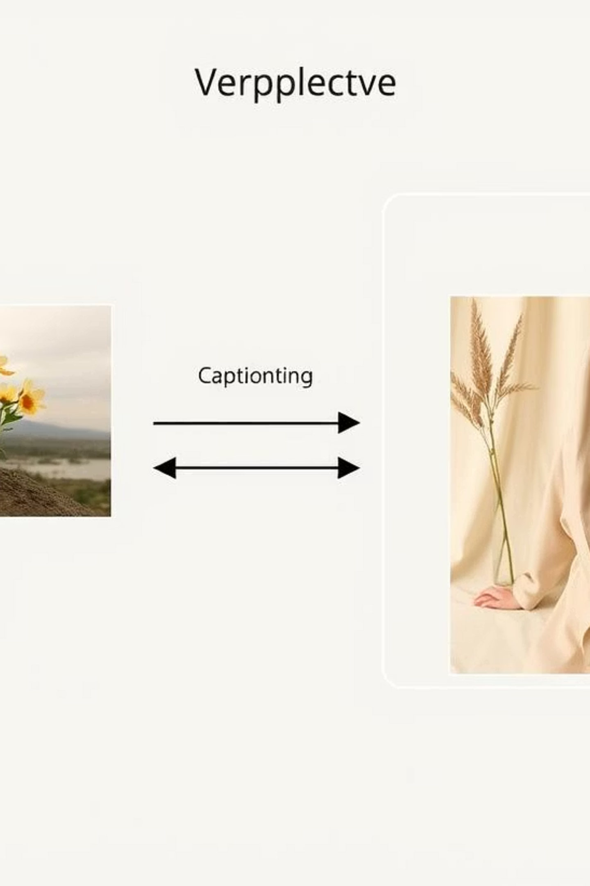
Project Architecture
Our system integrates both models to provide comprehensive image analysis.

Slide 8
Learning Outcomes & Future Scope
Learning Outcomes
Future Scope
Gained practical experience with deep learning models.
Real-time processing for live video feeds.
Understood the complexities of image-text generation.
Integration with other AI applications.
Improved skills in model integration and deployment.
Exploring more advanced models for higher accuracy.

Slide 9

Thank You!
Questions?

